Slide 1

Unit 1: Basic Discrete Structures
By: Joon Shakya
CSIT 2nd Semester
021BSCIT012

Slide 2

Sets

Slide 3
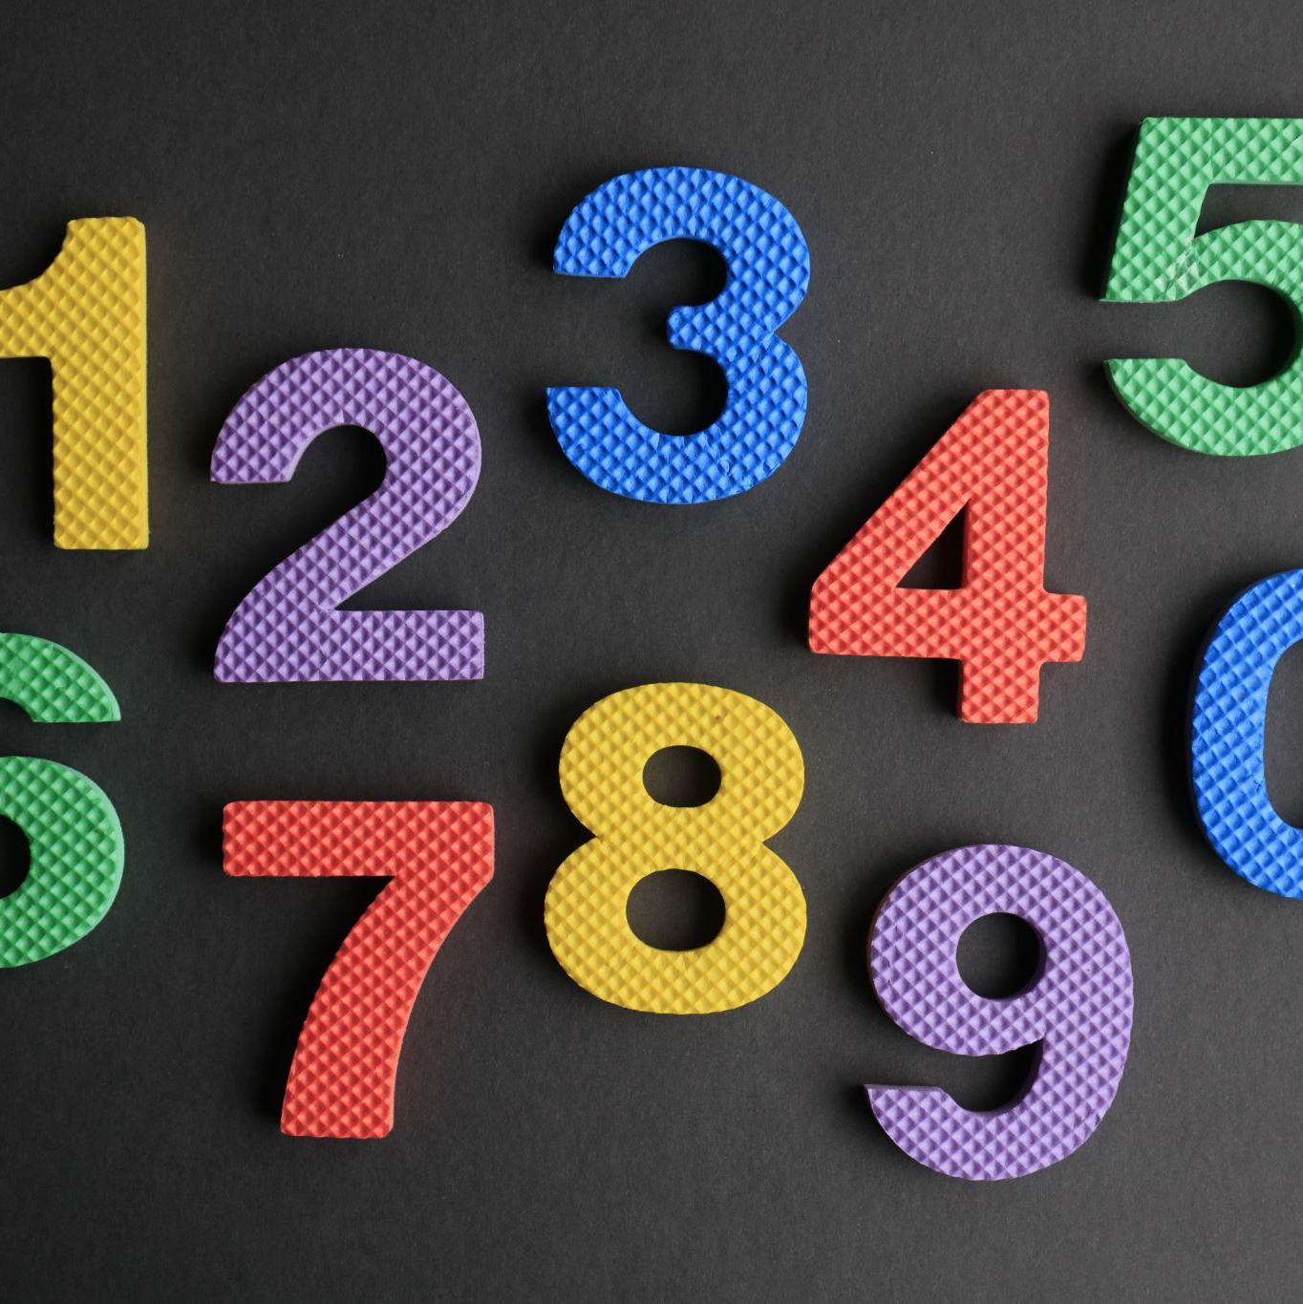
Set
Well-defined un-ordered collection of distinct objects
Set of all natural numbers
Set of all students of CSIT 2021 Batch

Slide 4
Set
Sets are generally denoted by capital letters
Members of the set are denoted by small letters.
If 1, 2, 3, are the elements of set A, then we write it as:
A = {1, 2, 3}

Slide 5

Representation of Sets
A set maybe specified by the following methods

Slide 6

Descriptive Method
In this method, a set is specified by a verbal description
N = Set of all natural numbers

Slide 7

Tabulated Method
In this method, a set is specified by listing all elements
V = {a, e, i, o, u}

Slide 8

Rule Method or Set Builder Method
In this method a set is specified by stating a characteristic property common to all elements in the set.
S = {x : x is an integer and 1 ≤ x ≤ 5}

Slide 9

Set Terminologies
Finite Set: Containing finite number of items
Infinite Set: Containing infinite number of items
Empty Set (Φ or {}): Containing no items
Unit Set: Containing only one element

Slide 10
Set Terminologies
Universal Set: Contains all elements under consideration of situation
Subset: Consists of some or all elements of another set
Power Set: The number of subsets that can be formed
Ordered Pair: A set of two elements ‘a’ and ‘b' written as is called a pair

Slide 11

Cartesian Product of Two Sets
The Cartesian product of two non-empty sets A and B is defined as the set of all possible ordered pairs such that a ∈ A and b ∈ B

Slide 12
Cartesian Product of Two Sets
Mathematically, we can write,
A × B = {(a, b) : a ∈ A, b ∈ B}
Let A = {1, 2} and b = {3, 4, 5}. Then:
A × B = {(1, 3), (1, 4), (1, 5), (2,3), (2, 4), (2, 5)}
B × A = {(3, 1), (3, 2), (4, 1), (4, 2), (5, 1), (5, 2)}

Slide 13

Venn Diagram
Such diagrams are called Venn diagrams
We usually represent the universal set by a rectangle and its subset by a circle
The elements of U are represented by the points within the rectangle while the elements of the subset of U is represented by the points within the circle

Slide 14
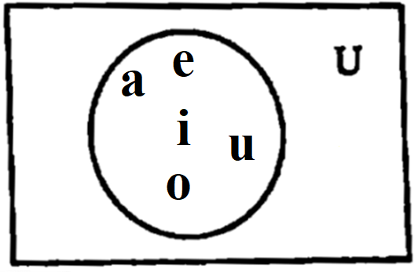
Venn Diagram
For illustration let us consider the set of vowels as V which is the subset of the universal set U, the English alphabets.
Then, V = (a, e, i, o, u) is represented in Venn diagram

Slide 15

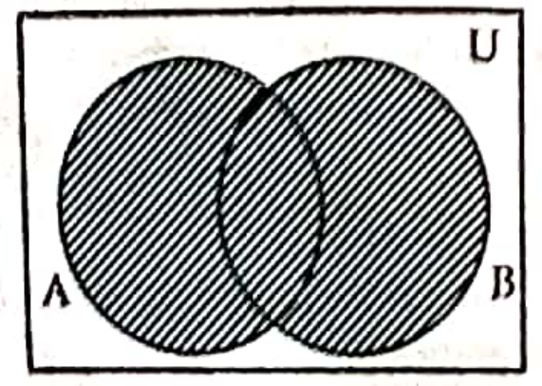
Set Operations
Union
The union of two sets A and B, denoted by A ∪ B is the set of only those elements which belong to either A or B or both A and B
Symbolically, we write this as:
A ∪ B = {x : x ∈ A or x ∈ B or x ∈ both A and B}

Slide 16
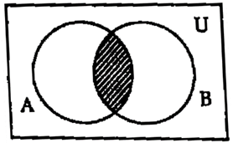
Set Operations
Intersection
The intersection of two sets A and B, denoted by A ∩ B is the set of only those elements which belong to both A and B.
Symbolically, we write this as:
A ∩ B = {x : x ∈ A and x ∈ B}

Slide 17
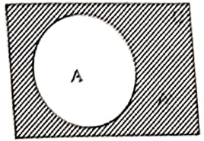
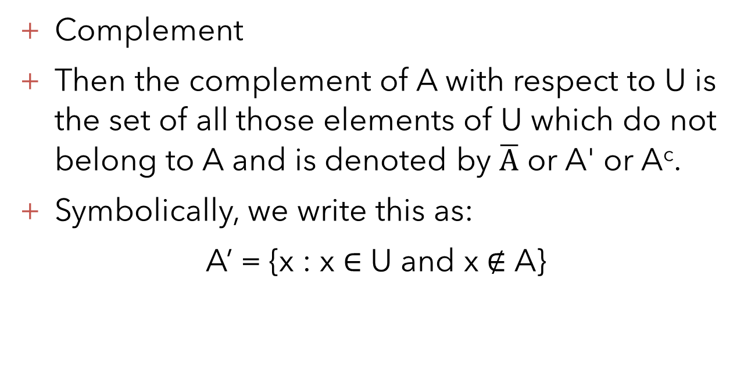
Set Operations
Complement
Then the complement of A with respect to U is the set of all those elements of U which do not belong to A and is denoted by $\overline{A}$ or A' or A^{c}.
Symbolically, we write this as:
A’ = {x : x ∈ U and x ∉ A}

Slide 18
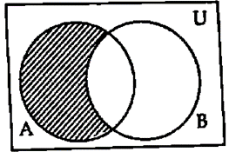
Set Operations
Difference
A difference B denoted by A – B is the set of all those elements which belong to A but not B.
Symbolically, we write this as:
A – B = {x : x ∈ A and x ∉ B)

Slide 19
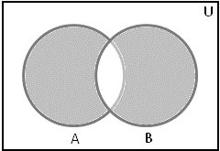
Set Operations
Symmetric Difference
The symmetric difference of two sets A and B denoted as A △ B is the set of elements which are in either of the sets, but not in their intersection.
Symbolically, we write it as:
A △ B = {x : x ∉ A ∩ B)
It is calculated as follows:
A △ B = (A – B) ∪ (B – A)

Slide 20
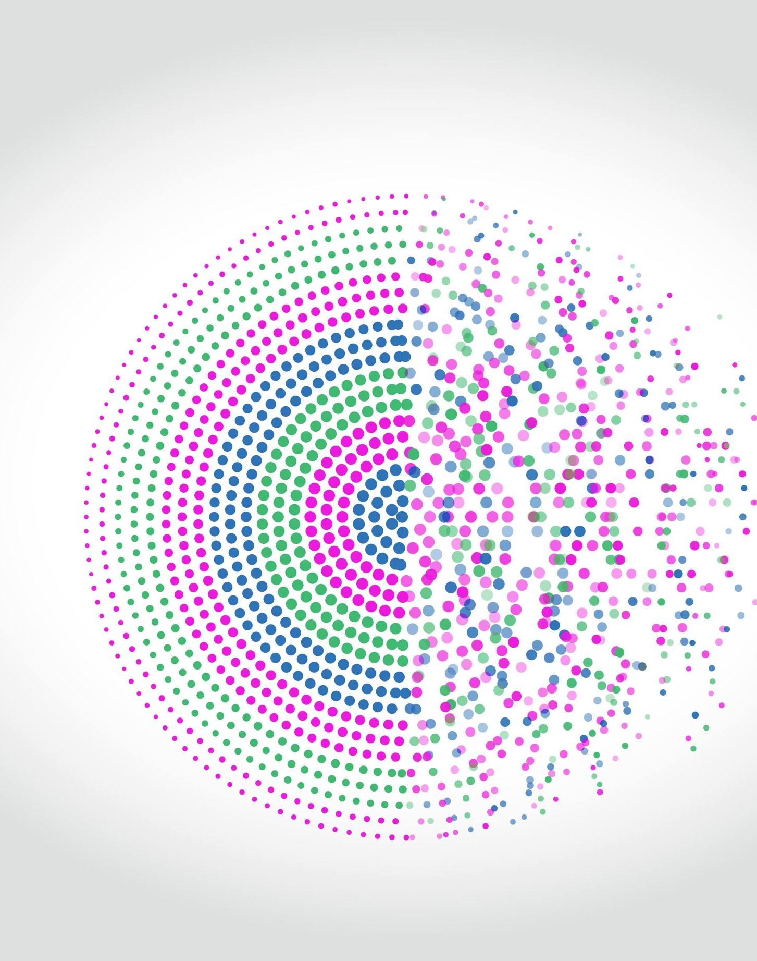
Set Identities

Slide 21
Identity Laws:
A ∪ Φ = A, A ∪ U = U
A ∩ Φ = Φ, A ∩ U = A
Idempotent Laws:
A ∪ A = A, A ∩ A = A
Commutative Laws:
A ∪ B = B ∪ A
A ∩ B = B ∩ A
Set Identities

Slide 22
Set Identities
Associative Laws:
A ∪ (B ∪ C) = (A ∪ B) ∪ C
A ∩ (B ∩ C) = (A ∩ B) ∩ C
Distributive Laws:
A ∪ (B ∩ C) = (A ∪ B) ∩ (A ∪ C)
A ∩ (B ∪ C) = (A ∩ B) ∪ (A ∩ C)

Slide 23

The laws Governing Complements

Slide 24
The laws Governing Complements
Complement:
(A’)’ = A A ∪ A’ = U
A ∩ A’ = Φ Φ’ = U U’ = Φ
Set Difference:
A – B = A ∩ B’ U – A = A’
A – U = Φ A – Φ = A
Φ – A = Φ A – A = Φ
De-Morgan’s Laws:
(A ∪ B)’ = A’ ∩ B’
(A ∩ B)’ = A’ ∪ B’

Slide 25

Inclusion-Exclusion Principle
Let A and B be any two disjoint sets then we extensively use inclusion exclusion principle
Given set A and set B the union of A and B is given by the formula
| A ∪ B | = | A | + | B | - | A ∩ B |

Slide 26
Inclusion-Exclusion Principle
Similarly, for any finite sets A, B and C we have,
n(A ∪ B ∪ C) = n(A) + n(B) + n(C) - n(A ∩ B) - n(B ∩ C) - n(A ∩ C) + n(A ∩ B ∩ C).

Slide 27
Computer Representation of Sets
One method to represent sets in computer is to store the elements of set in an unordered list.
If this method is used, the operations of computing the union, intersection of sets would be time consuming because each of these operations would require large time in searching for elements.

Slide 28
Computer Representation of Sets
So, we use method for storing elements using arbitrary ordering of the elements.
Specify an arbitrary ordering of elements of U, for example a₂, a₂, ......, a_{n} represent a subset A of U with bit sting of length n, where i^{th} bit in this string is 1 if a_{i} ∈ A and 0 if a_{i} ∉ A.
Example:
Let U= {1, 2, 3, 4, 5, 6, 7, 8, 9, 10}

Slide 29
Computer Representation of Sets
The bit string that represents the set of odd integers in U, {1, 3, 5, 7, 9}, has a one bit in the first, third, fifth, seventh, and ninth positions. It is 1010101010.
The bit string that represents the subset of even integers in U, {2, 4, 6, 8, 10}, It is 0101010101.
The set of all integers in U that do not exceed 5, {1, 2, 3, 4, 5}, is 1111100000.
To find the bit string for the complement of a set from the bit string, change interchange 1s and 0s.

Slide 30
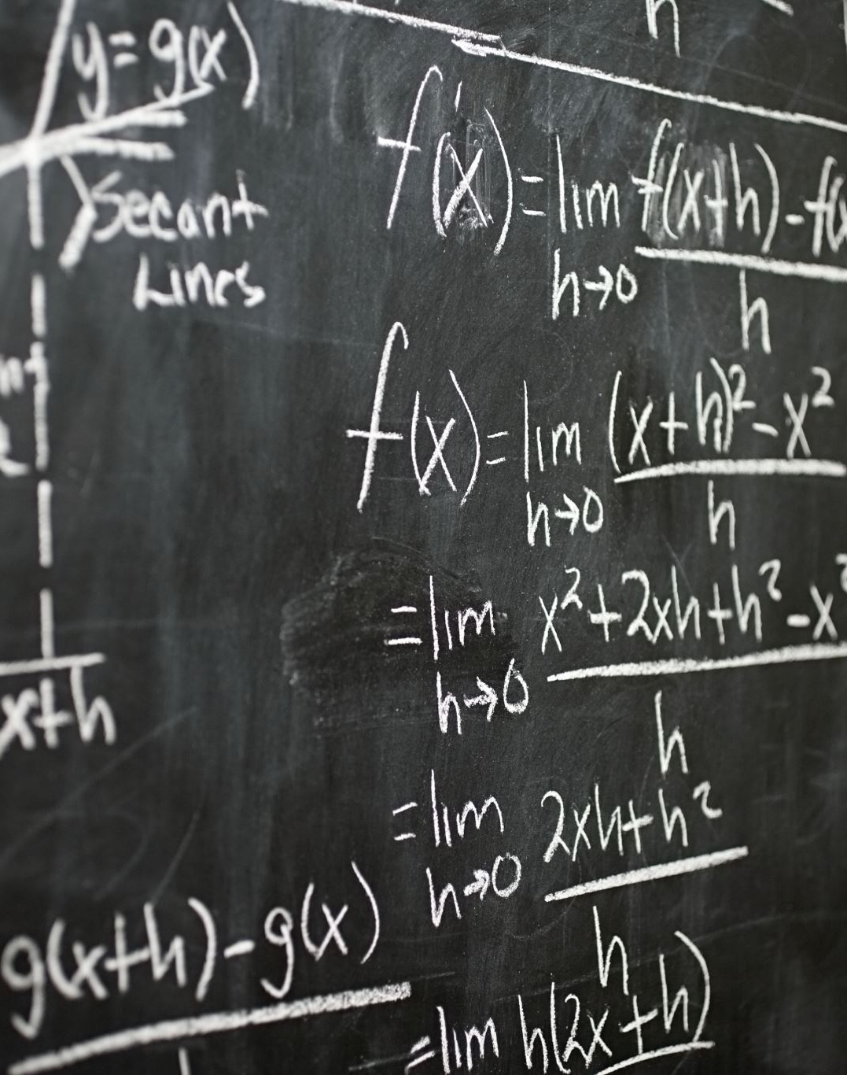
Functions

Slide 31

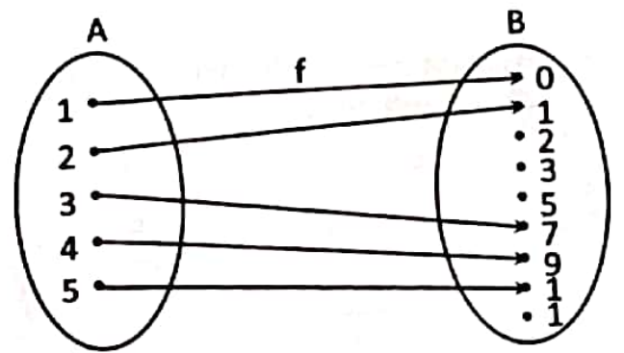
Basic Concept
Let A and B be two non-empty sets. A function f from A to B is a set of ordered pairs with the property that for each element x in A there is a unique element y in B.
Example:
Let A = {1, 2, 3, 4, 5), B = {0, 1, 2, 3, 5, 7, 9, 12, 13) and f = {(1, 1), (2, 0), (3, 7), (4, 9), (5, 12)}, then f is a function from A to B because each element of A has an unique image in B which can be expressed by a diagram as,

Slide 32
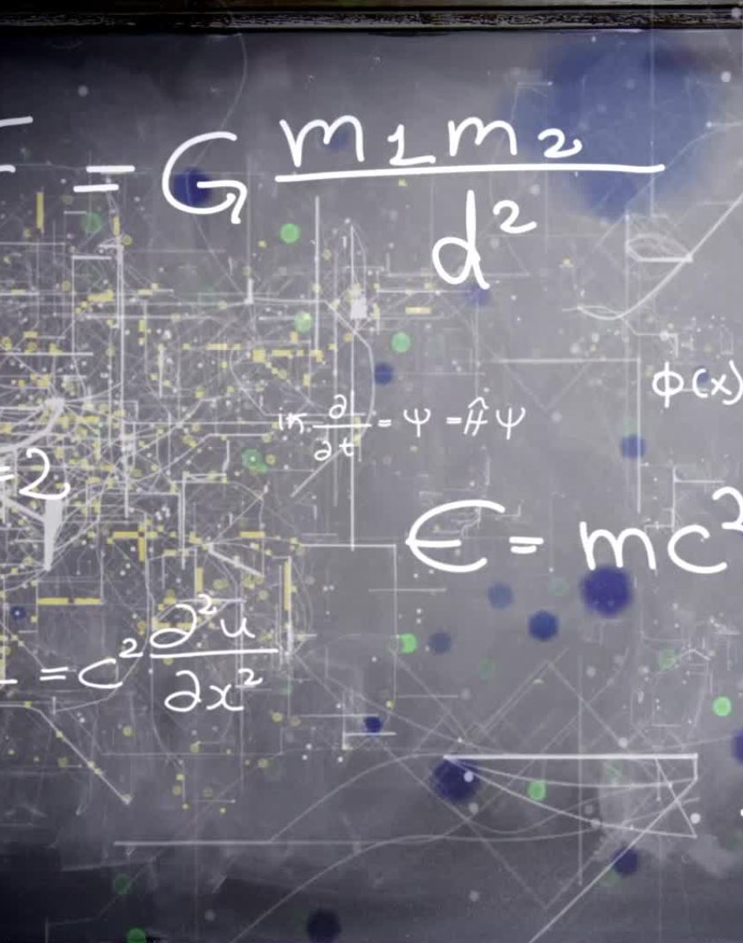
Sum and Product of Functions

Slide 33
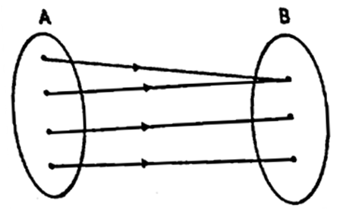
Injective Functions
A function from A to B is one-to-one if for all x₁, x₂ ∈ A such that that f(x₁) = f(x₂) implies x₁ = x₂.
We can express that f is one to one using quantifiers as ∀ x₁ ∀ x₂ (f(x₁) = f(x₂) => x₁ = x₂) where universe of discourse is the domain of the function.
A function f from A to B is an onto function if every element of B is the image of some element in A

Slide 34
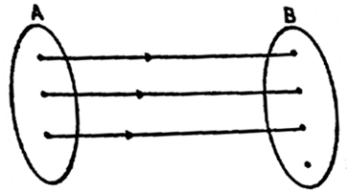
Surjective Functions
A function f from A to B is an onto function if every element of B is the image of some element in A. We can express that f is surjective using quantifiers as: ∀ y ∃ x (f(x) = y)

Slide 35
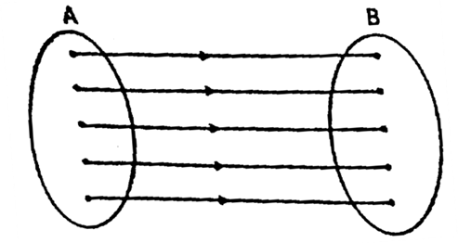
Bijective Functions
A function f from A to B is said to be bijective if it is injective and surjective.

Slide 36
Let f : A → B be a function which is bijective, then the inverse function of f is the function that assigns to an element b belonging to set B, the unique element a in A such that f(a) = b. the inverse function of f is denoted by f⁻¹. Hence f⁻¹(b) = a when f(a) = b.
A function f : A → B is invertible if its inverse relation f⁻¹ is a function from B to A. In general, the inverse relation f⁻¹ may not be a function.
In the case of two functions, we define inverse function as, Let f : A → B and g : B → A be two functions then g is said to be inverse of f if gof = I_{A} and fog = I_{B}.
Inverse of a function

Slide 37
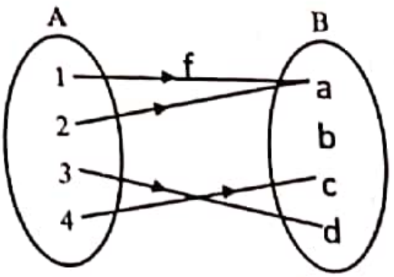
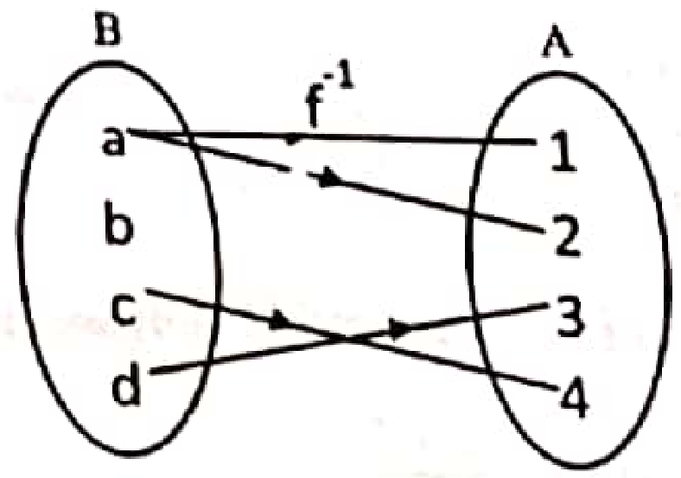
Inverse of a function

Slide 38
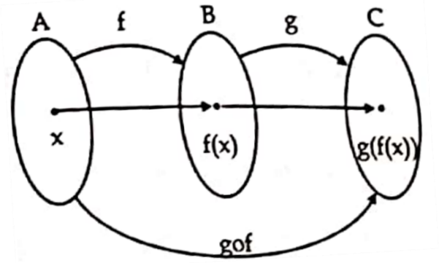
Composition of functions
Let f : A → B and g : B → C be two functions. The composition of f and g, denoted by gof, is a new function from A to C defined by (gof)(x) = g(f(x)), for all x ∈ A.

Slide 39
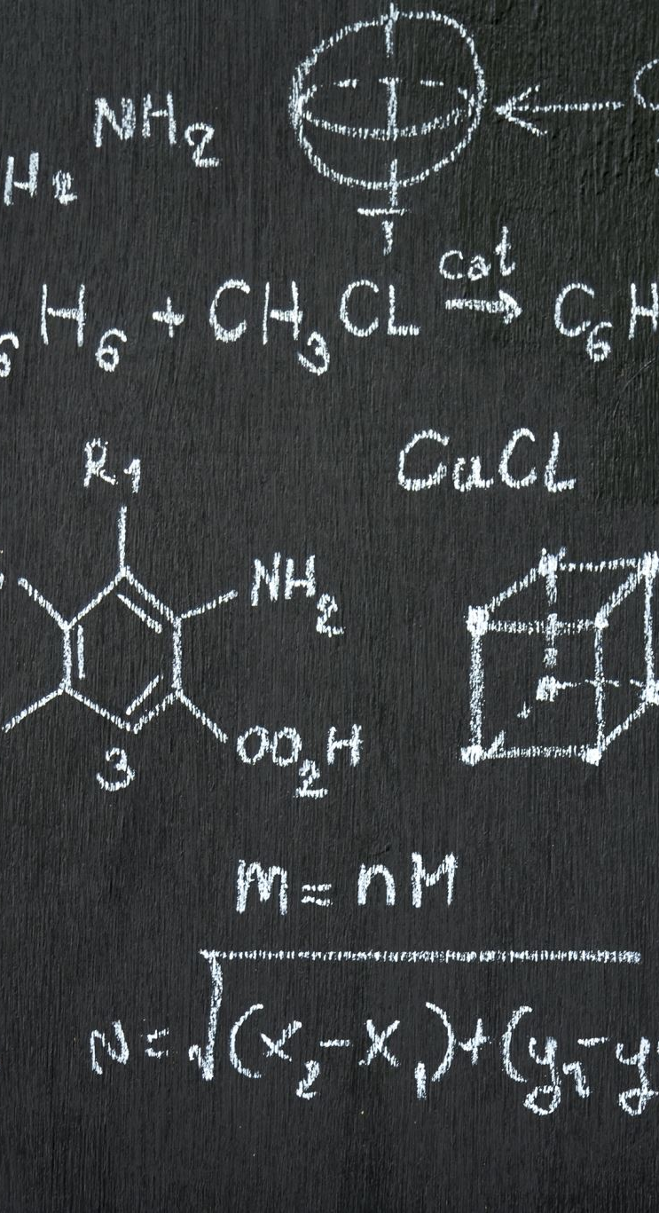
Graph of Functions
We can associate a set of pairs in A × B to each of functions from A to B. This set of pairs is called graph of functions.
Let f be a function from set A to set B then graph of function f is set of ordered pairs {(a, b) : a ∈ A and f(a) = B}.

Slide 40
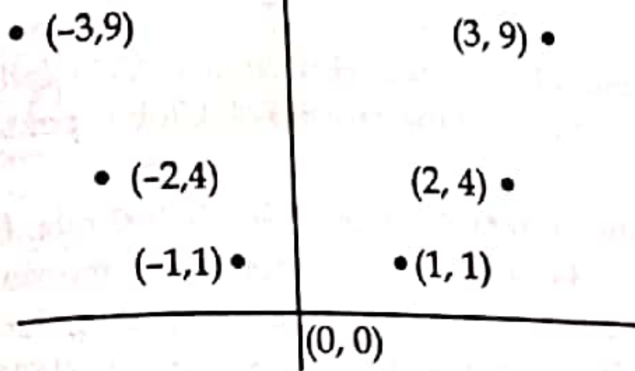
Graph of Functions
Example:
To find the graph of the function f(x) = x² from the set of integers to set of integers.
The graph of f is the set of ordered pairs of the form (x, f(x)) = (x, x²) where x is an integer. This graph is displayed in figure below:

Slide 41
Functions for Computer Science
Floor Function
Let x be a real number then ⌊ x ⌋ called the floor function of x, assigns the real number x to the largest integer that is less than or equal to x
The floor function is often also called the greatest integer function
⌊ 65.34 ⌋ = 65

Slide 42
Functions for Computer Science
Ceiling Function
If x is a real number, then ⌈ x ⌉ called the ceiling function of x, assigns the real number x to the smallest integer that is greater than or equal to x.
⌈ 65.34 ⌉ = 66

Slide 43
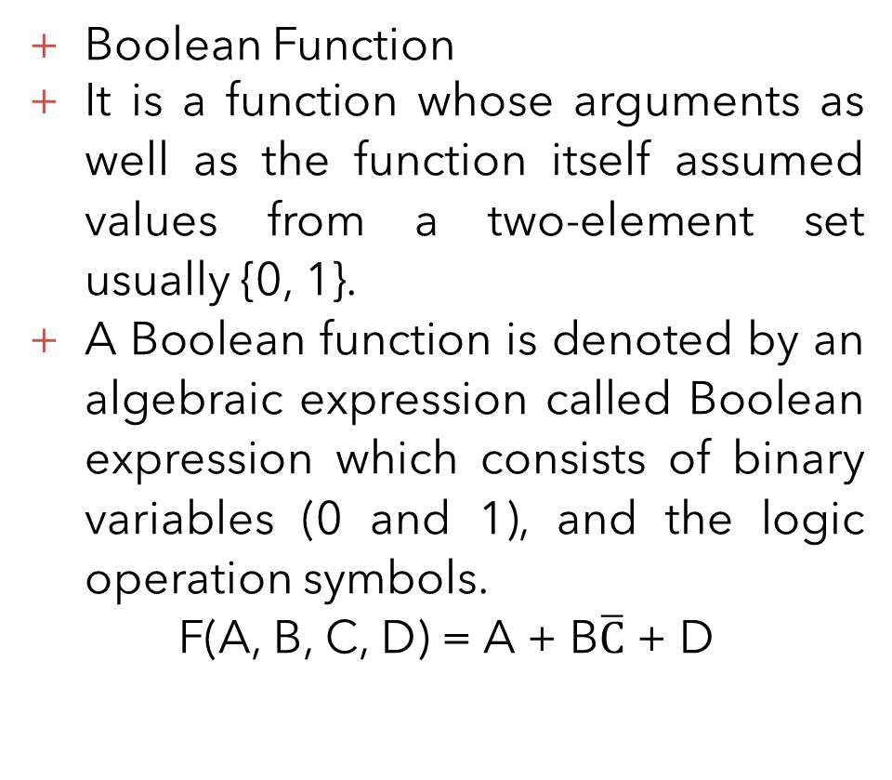
Functions for Computer Science
Boolean Function
It is a function whose arguments as well as the function itself assumed values from a two-element set usually {0, 1}.
A Boolean function is denoted by an algebraic expression called Boolean expression which consists of binary variables (0 and 1), and the logic operation symbols.
F(A, B, C, D) = A + B$\overline{C}$ + D

Slide 44
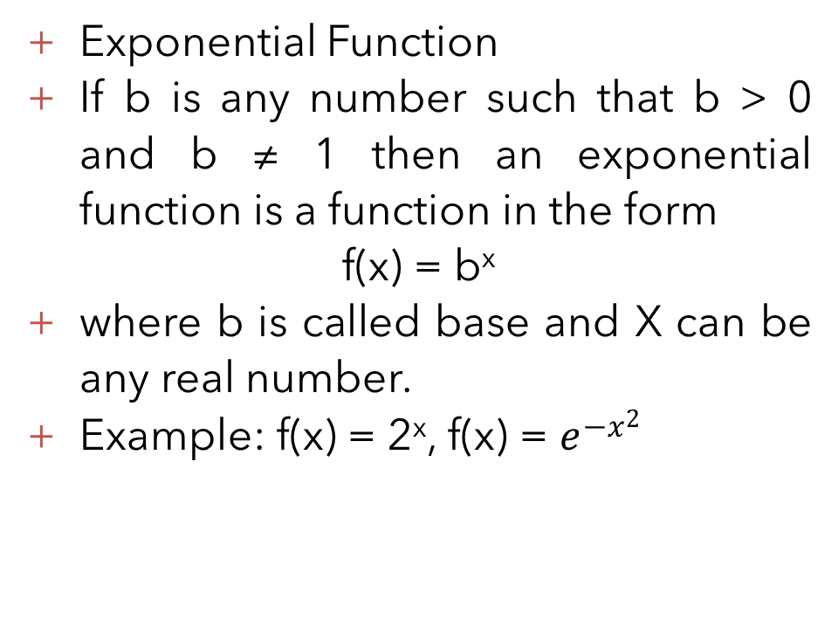
Functions for Computer Science
Exponential Function
If b is any number such that b > 0 and b ≠ 1 then an exponential function is a function in the form
f(x) = b^{x}
where b is called base and X can be any real number.
Example: f(x) = 2^{x}, f(x) = $e^{{−x}^{2}}$

Slide 45

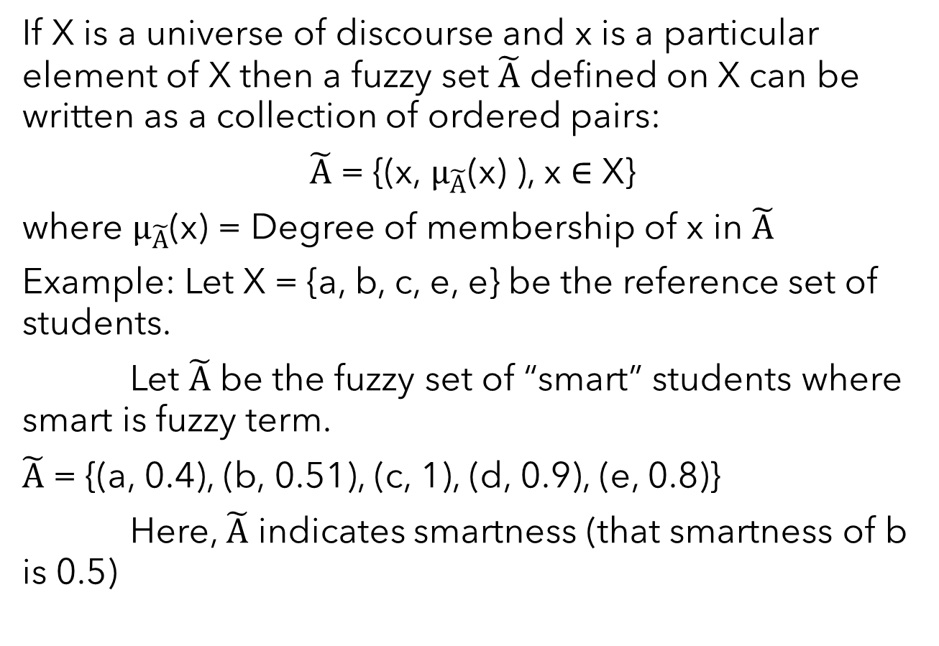
Fuzzy Sets
If X is a universe of discourse and x is a particular element of X then a fuzzy set $\tilde{A}$ defined on X can be written as a collection of ordered pairs:
$\tilde{A}$ = {(x, $μ_{\tilde{A}}$(x) ), x ∈ X}
where $μ_{\tilde{A}}$(x) = Degree of membership of x in $\tilde{A}$
Example: Let X = {a, b, c, e, e} be the reference set of students.
Let $\tilde{A}$ be the fuzzy set of “smart” students where smart is fuzzy term.
$\tilde{A}$ = {(a, 0.4), (b, 0.51), (c, 1), (d, 0.9), (e, 0.8)}
Here, $\tilde{A}$ indicates smartness (that smartness of b is 0.5)

Slide 46

Membership Functions
Membership functions characterize fuzziness whether the elements in fuzzy set are discrete or continuous
Membership functions are operated by graphical forms
The value of membership function of x when 0 means that x is not a member of the fuzzy set; value 1 means that x is fully a member of the fuzzy set

Slide 47

Fuzzy Set Operations
Intersection (Fuzzy “AND”):
The membership function of the Intersection of two fuzzy sets A and B with functions μ_{A} and μ_{B} is respectively defined as the minimum of the two individual membership functions. This is called the minimum criterion.
μ_{A ∩ B} = min(μ_{A}, μ_{B})

Slide 48
Fuzzy Set Operations
Union (Fuzzy “OR”):
The membership function of the union of two fuzzy A and B with membership function μ_{A} and μ_{B} is respectively defined as the maximum of the two individual membership functions. This is called the maximum criterion.
μ_{A} _{∪ B} = max(μ_{A}, μ_{B})

Slide 49
Fuzzy Set Operations
Complement (Fuzzy “NOT”):
The membership function of the complement of a fuzzy A with membership function μ_{A} is defined as the negation of the specified membership functions. This is called negation criterion.
μ_{A’} = 1 - μ_{A}

Slide 50

Sequences and Summations

Slide 51
Basic Concept of Sequences
A sequence is a function from a subset of the set of integers to a set S
We use the notation a_{n} to denote the image of the integer n. We call a_{n} a term of the sequence.
We use notation {a_{n}} to represent a sequence a₁, a₂, a₃, …, a_{n}. Here, a_{i} represents the individual terms of sequence {a_{n}}.

Slide 52
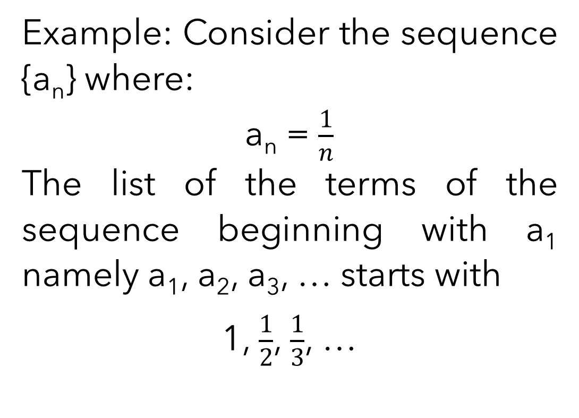
Basic Concept of Sequences
Example: Consider the sequence {a_{n}} where:
a_{n} = $\frac{1}{n}$
The list of the terms of the sequence beginning with a₁ namely a₁, a₂, a₃, … starts with
1, $\frac{1}{2}$, $\frac{1}{3}$, …

Slide 53

Geometric Progression
A geometric progression is the sequence of the form:
a, ar, ar², ar³, …, ar^{n}
where the initial term ‘a’ and the common ratio ‘r’ are real numbers.
A geometric progression is a discrete analogue of the sequential function f(x) = ar^{n}.
Example: The sequence {b_{n}} with b_{n} = 2.5^{n} = 2, 10, 50, 250, 1250, …

Slide 54

Arithmetic Progression
An arithmetic progression is a sequence of the form:
a, a + d, a + 2d, …, a + nd
where the initial term ‘a’ and the common difference ‘d’ are real numbers.
An arithmetic progression is a discrete analogue of the sequential function
f(x) = a + xd.
Example: The sequence {b_{n}} with b_{n} = -1 + 4n = -1, 3, 7, 11, 15, …

Slide 55
Single Summation
Submission is the operation of adding a sequence of numbers.
If numbers are added sequentially from left to right, any intermediate result is a partial sum.
The numbers to be summed called (addends or sometimes summands) maybe integers rational numbers or real numbers.

Slide 56
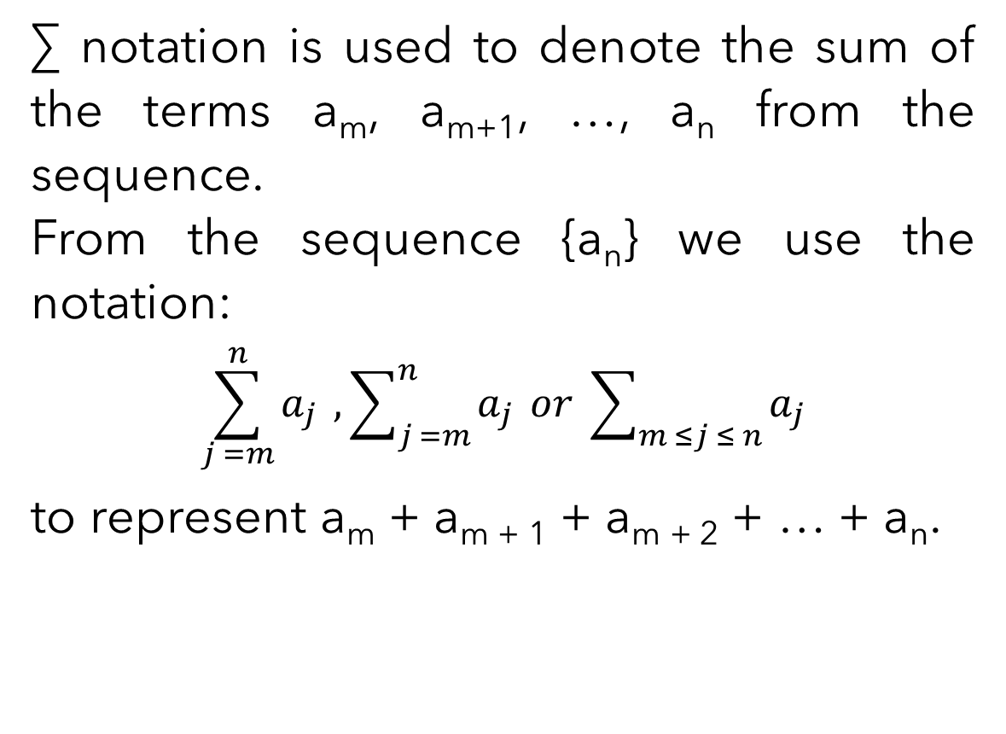
Single Summation
∑ notation is used to denote the sum of the terms a_{m}, a_{m+1}, …, a_{n} from the sequence.
From the sequence {a_{n}} we use the notation:
$$\sum_{j =m}^{n}{a_{j}} , \sum_{j =m}^{n}{a_{j}} or \sum_{m ≤j ≤ n}{a_{j}}$$
to represent a_{m} + a_{m + 1} + a_{m + 2} + … + a_{n}.

Slide 57
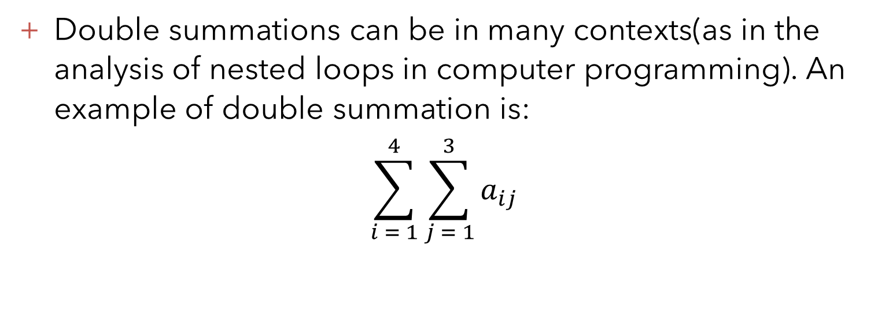
Double Summation
Double summations can be in many contexts(as in the analysis of nested loops in computer programming). An example of double summation is:
$$\sum_{i = 1}^{4}{\sum_{j = 1}^{3}{a_{ij}}}$$

Slide 58

Thank you

